Slide 1
Benchmarking & Beyond: Improve Energy and Operational Efficiencies Throughout Your Portfolio

Slide 2


Jeff Gerwig
Colliers International
Emily Pearce
Waypoint Building Group
Notes:
Emily:
What is benchmarking
What is the value of benchmarking, esp in CRE world
How do you benchmark (e.g. ENERGY STAR, other tools?)
What regulations are out there currently on benchmarking (e.g. IMT map of ordinances and building types required)
What do you do after benchmarking – “Beyond benchmarking”?
Jeff:
Colliers Internal Benchmarking Requirement, original and updated versions
How Colliers meets their benchmarking goals
How does Colliers enforce the requirement
What does Colliers do with the data and how does this help clients
What has Colliers learned along the way that could help others in CRE
Future plans

Slide 3
What is Benchmarking?

Slide 4

Value of Benchmarking for Commercial Real Estate
Notes:
EM

Slide 5
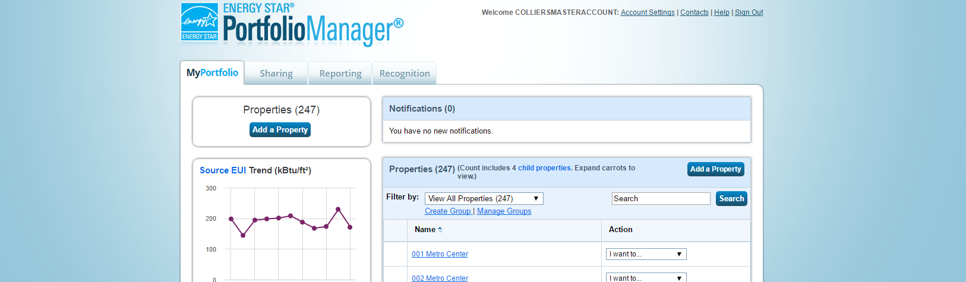



How Do You Benchmark?
Notes:
EM

Slide 6
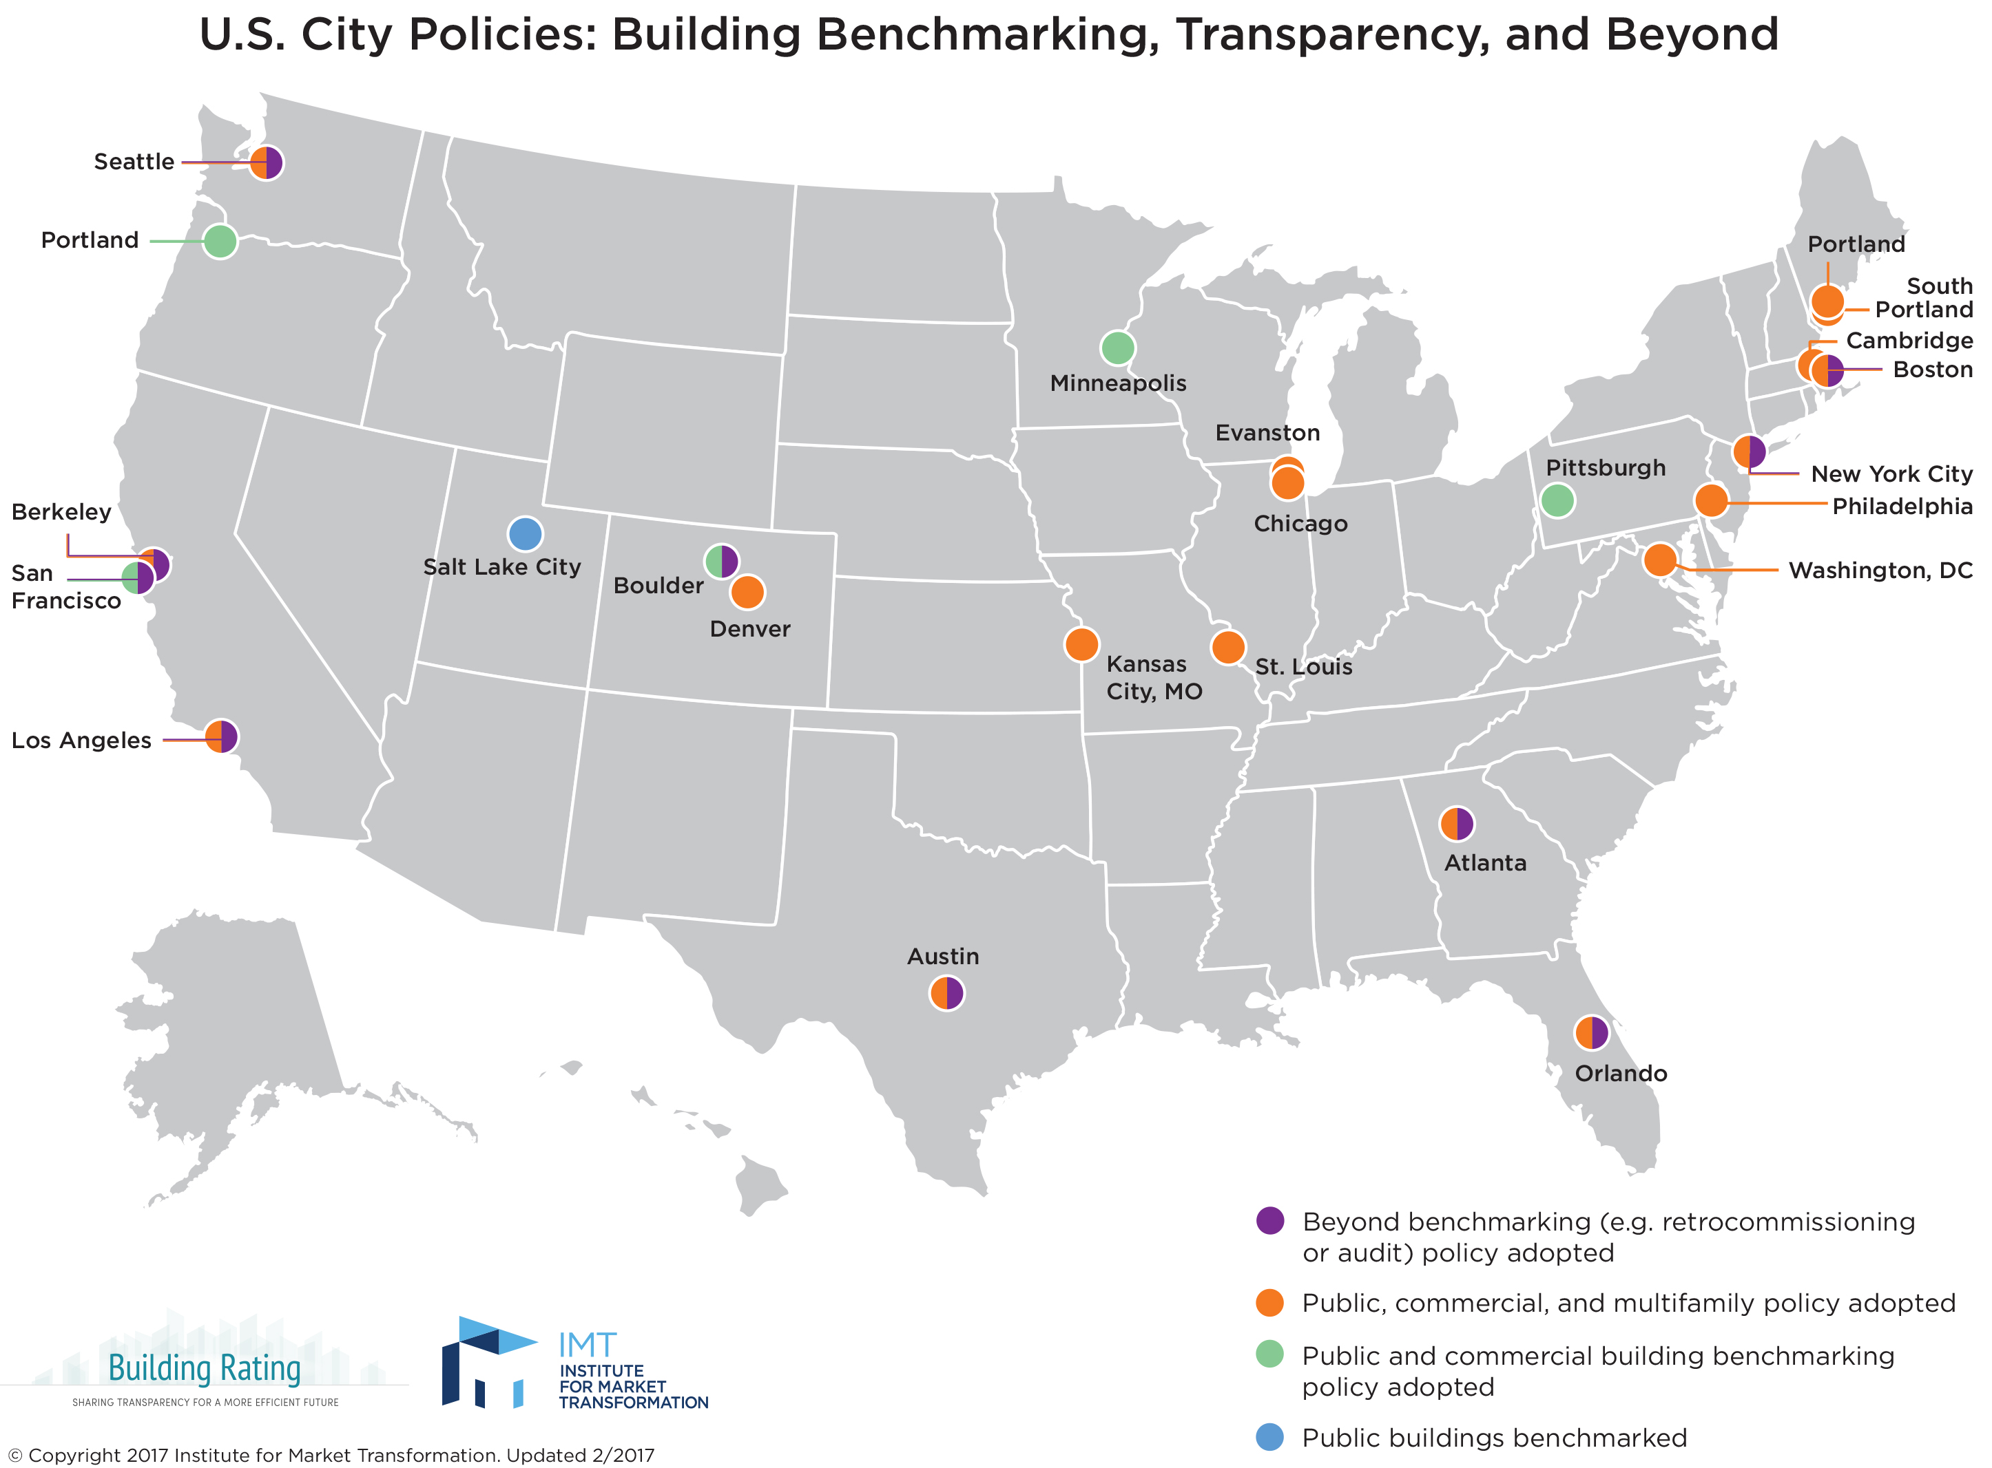
Benchmarking Ordinances
Notes:
EM

Slide 7

Beyond Benchmarking
Notes:
EM

Slide 8
Benchmarking for Property Management Companies
Notes:
JEFF

Slide 9
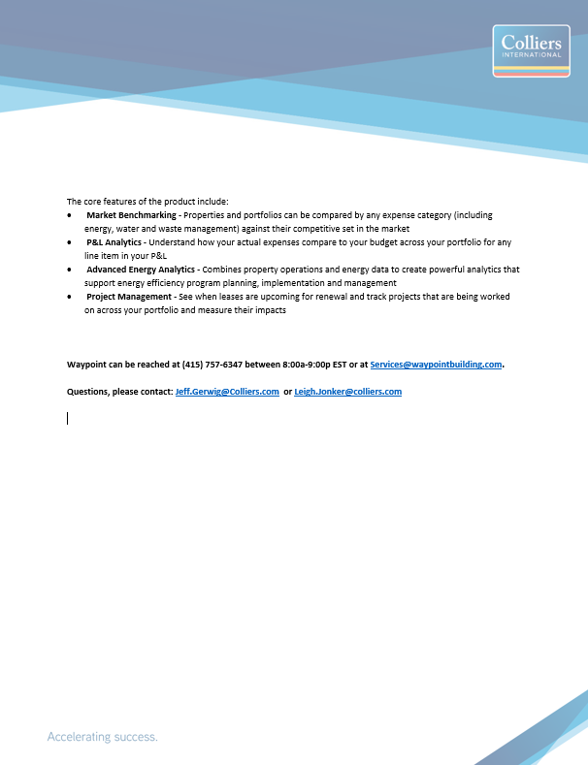
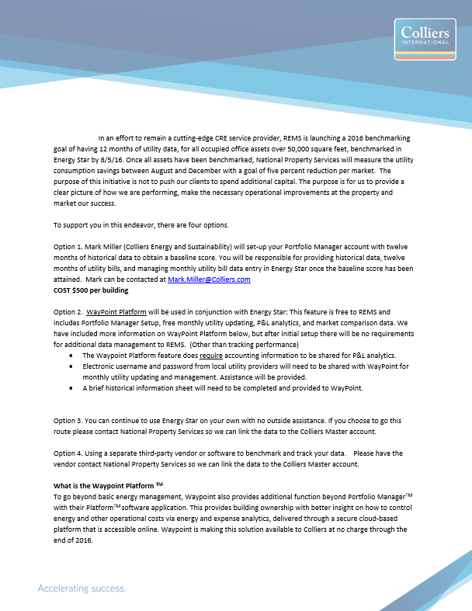
Colliers Benchmarking Requirements
Notes:
JEFF

Slide 10
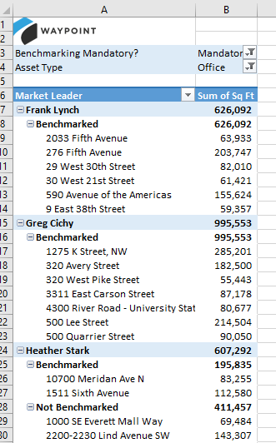
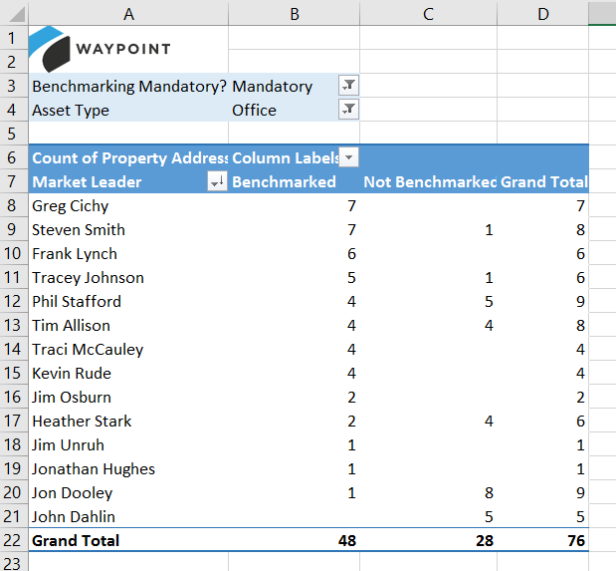
How Colliers Meets Benchmarking Goals
Notes:
JEFF

Slide 11

Enforcing Benchmarking Requirements
Notes:
JEFF

Slide 12

What to do with all the data, and how it helps clients
Notes:
JEFF

Slide 13

Lessons Learned Along the Way
Notes:
JEFF

Slide 14

What’s next?
Notes:
JEFF

Slide 15
Jeff Gerwig
Colliers International
Jeff.Gerwig@colliers.com
Emily Pearce
Waypoint Building Group emilypearce@waypointbuilding.com
Notes:
Emily:
What is benchmarking
What is the value of benchmarking, esp in CRE world
How do you benchmark (e.g. ENERGY STAR, other tools?)
What regulations are out there currently on benchmarking (e.g. IMT map of ordinances and building types required)
What do you do after benchmarking – “Beyond benchmarking”?
Jeff:
Colliers Internal Benchmarking Requirement, original and updated versions
How Colliers meets their benchmarking goals
How does Colliers enforce the requirement
What does Colliers do with the data and how does this help clients
What has Colliers learned along the way that could help others in CRE
Future plans

